Slide 1
LOGISTIC REGRESSION
Machine Learning meeting

Slide 2
contenu
Introduction​
​Build a mathematical model​

Slide 3
Introduction
Logistic regression is a statistical analysis method used to predict data values based on previous observations of the dataset.
The purpose of logistic regression is to estimate the probability of events, including determining the relationship between features from which to predict the probability of the results, so for logistic regression we will have:
Input: input data (we will consider having two labels, 0 and 1).
Output: The probability that the input data falls into label 0 or label 1.

Slide 4
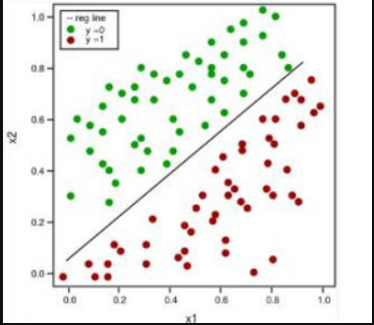
In the figure above we call the blue points label 0 and the red points label 1 for logistic regression we will know for each point what is the probability of falling into label 0 and what is the probability of falling into label 1, we can see that between blue and red there is a straight line to divide very clearly but if data points that are not on either side but are mixed together, how will we divide? then we will call the dataset with a lot of noise and we have to deal with those noises in advance.

Slide 5
Logistic Regression Model

Slide 6



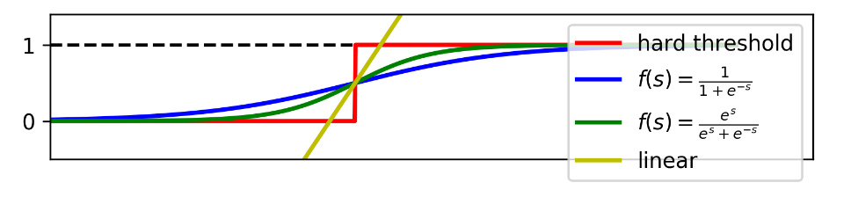
Output of Linear regression :
Output of Perceptron Learning Algorithm:
The predicted output of logistic regression is usually written collectively in the form of:
Where θ is called a logistic function. Some of the activations for the linear model

Slide 7
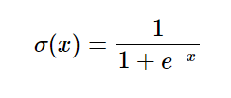
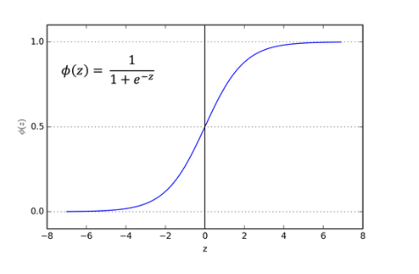

Sigmoid function:
Graph:
Is a continuous function and takes values in the range (0;1) (∃x for ∀c we have limx→cf(x)=f(c))
Because it is a continuous function, the sigmoid function will have a derivative at every point.
Derivative

Slide 8
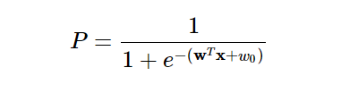
Apply the sigmoid function to convert the value wTx+w0 into the probability to conclude the value of the variable y from which to determine the label of input x:
Notes:
Áp dụng hàm sigmoid để chuyển giá trị wTx+w0 thành xác suất để kết luận giá trị của biến y từ đó để xác định được nhãn của input x:
Đây chính là mô hình của logistic regression.

Slide 9
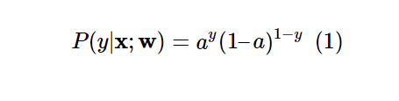
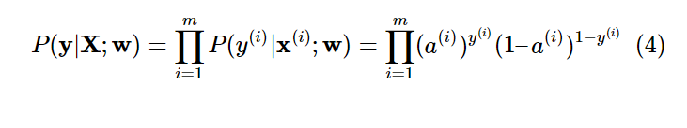
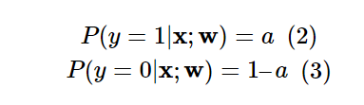
Suppose the probability for input x to fall into label 1 is σ(wTx+b) so the probability for input x to fall into label 0 would be 1–σ(wTx+b). Note that for logistic regression in this article we will have two labels, 0 and 1, σ is the sigmoid function. Set a=σ(wTx+b), according to the Bernoulli distribution we have:
Inside:
- P(y|x;w) is the probability of falling into the y label with input x and the weight set w.
– y takes a value of 0 or 1.
- a is the value that the model predicts, this value is the probability.
Notes:
Mục tiêu của việc cho mô hình học là ta đi điều chỉnh bộ trọng số w sao cho giá trị hàm mất mát đạt giá trị nhỏ nhất.

Slide 10
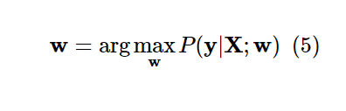
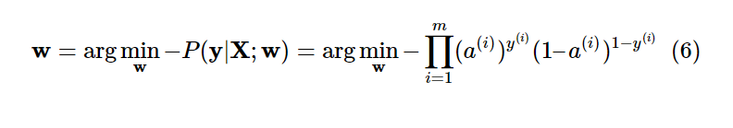
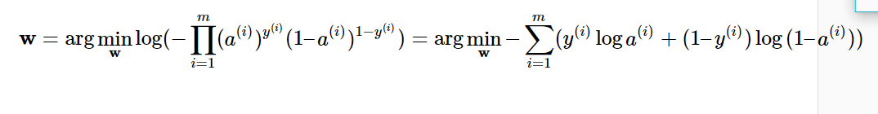
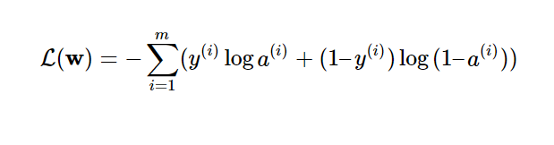
Our goal is to estimate the value of the weight set w such that P(y| X;w) reaches the maximum value:
Loss function:
Notes:
Mục tiêu của việc cho mô hình học là ta đi điều chỉnh bộ trọng số w sao cho giá trị hàm mất mát đạt giá trị nhỏ nhất.

Slide 11
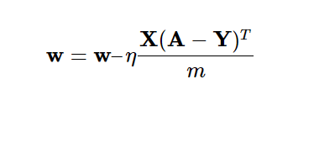
Updated values for the weight set:
Notes:
Mục tiêu của việc cho mô hình học là ta đi điều chỉnh bộ trọng số w sao cho giá trị hàm mất mát đạt giá trị nhỏ nhất.

Slide 12
THANK YOU

